Slide 1

Movie Recommender
Debasis Chatterjee

Slide 2
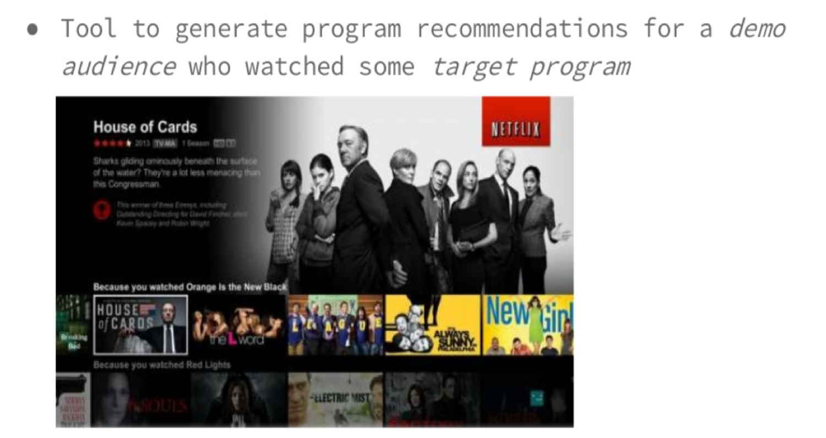

Problem Statement

Slide 3

Problem Statement
The movieLens dataset is most often used for the purpose of recommender systems which aim to predict user movie ratings based on other users’ ratings.
In other words it was expected that users with similar taste will tend to rate movies with high correlation.

Slide 4

Dataset Description
Dimensions:
100,000 ratings (1-5) from 943 users on 1682 movies.
Each user has rated at least 20 movies.
Simple demographic info for the users (age, gender, occupation, zip)

Slide 5

Dataset Description
Major Variable Description
Movie
Movie ID
Movie Title
Released Date
Movie Genre
Video Release Date
User
User ID
User age
User Gender
User Occupation
User Zip code

Slide 6
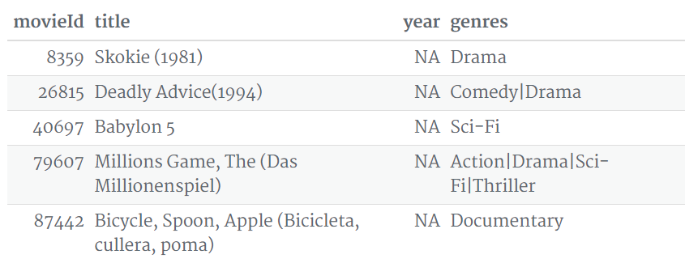
Dataset Description
Missing Values & Solution:
Most of the movies have their debut year added to their names – It was extracted this into separate columns.
Genres columns contain multiple categories per row – It was separated them into one category per row.

Slide 7
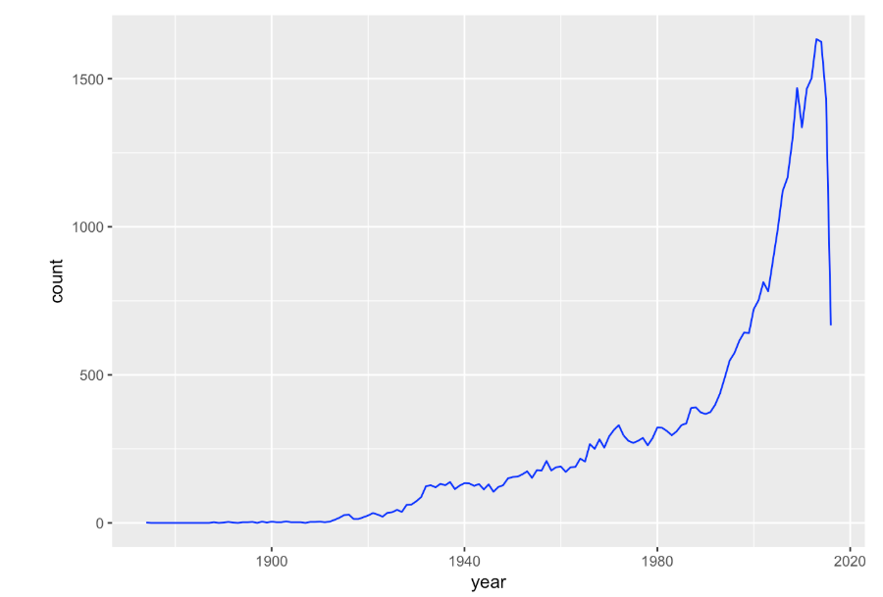
Descriptive Analysis
How many movies were produced per year?

Slide 8
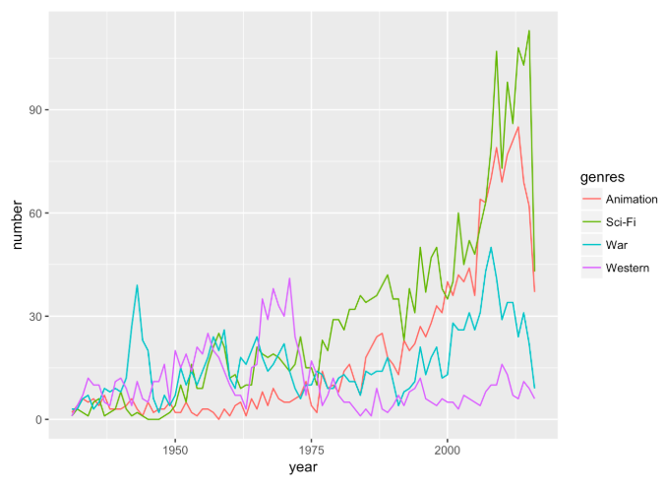
Descriptive Analysis
What were the most popular movie genres year by year?

Slide 9
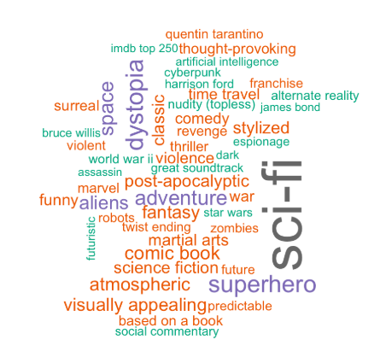
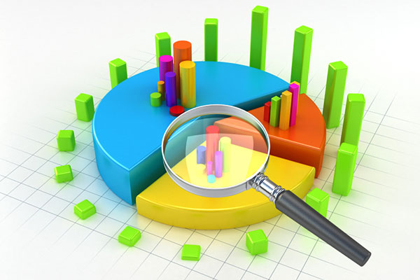
Descriptive Analysis
What tags best summarize a movie genre?

Slide 10

Challenges In Data
There are multiple files in the original data folder
Big data size which is difficult to process in R
Some data columns may contain multiple variables

Slide 11
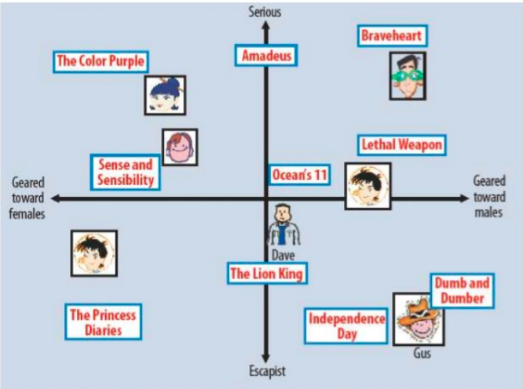

Model & Evaluation Methods
        Latent Factor Methods
Classification Problem:
ROC (Probability curve)
AUC (Degree of separation)
  1 ←-------→ 0
  1 Good model
  0 Bad model (Reciprocating)
  0.5 (No class separation)

Slide 12
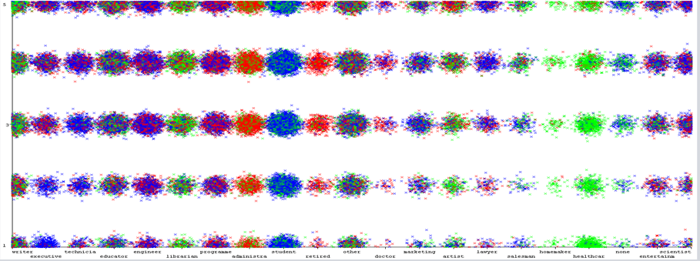
K-Means Clustering
Occupation to rating:
Some occupations such as retired people and doctors are more likely to give high ratings.
Some occupations such as retired people and doctors are more likely to give high ratings.

Slide 13
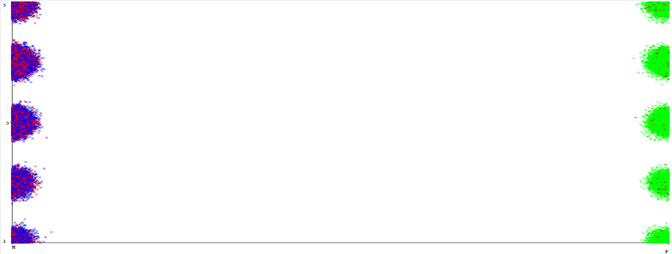
K-Means Clustering
Sex to rating:
Sex difference nearly makes no effect on ratings.
Sex difference nearly makes no effect on ratings.

Slide 14
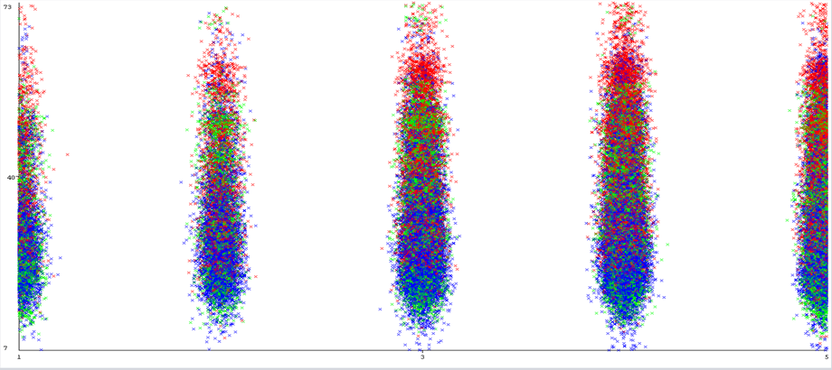
K-Means Clustering
Age to rating:
Those people( age>40) are inclined to rate higher than those younger people.

Slide 15

The Item-Based Collaborative Filtering
Approaches:
1) Predict if a user likes an item based on the item descriptions (movie genres). This can be done by predicting user movie ratings.
2) Assume that users like similar items, and retrieve movies that are closest in similarity to a user’s profile, which represents a user’s preference for an item’s feature.

Slide 16
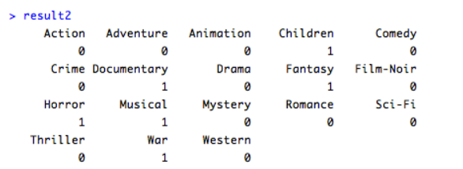
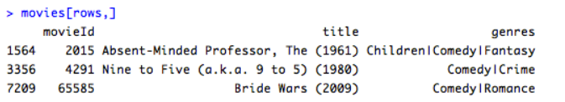
The Item-Based Collaborative Filtering

Slide 17
User Based CollaborativeFiltering
Combination of your experience and experiences of other people
User vs Item matrix and KNN algorithm
User/Movie | Avengers | Iron Man | Thor
Omkar | 4 | ? | 3.5
Li | 5 | 4 | ?
Harsh | ? | 5 | 3

Slide 18

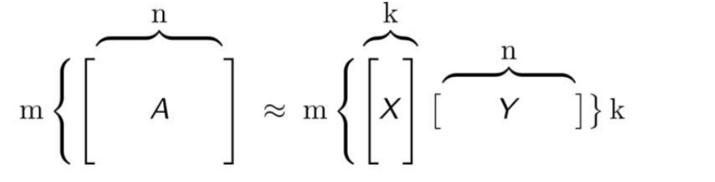
Confusion Matrix
How it Works?
A = Rating matrix, m respondents, n movies
X = User matrix, m respondents, k latent features
Y = Item matrix, n movies, k latent features

Slide 19
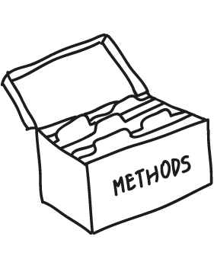
User Based CollaborativeFiltering
Method: UBCF
Similarity Calculation Method: Cosine Similarity
Nearest Neighbors: 30
The predicted item ratings of the user will be derived from the 5 nearest neighbors in its neighborhood.
When the predicted item ratings are obtained, the top 10 most highly predicted ratings will be returned as the recommendations.

Slide 20
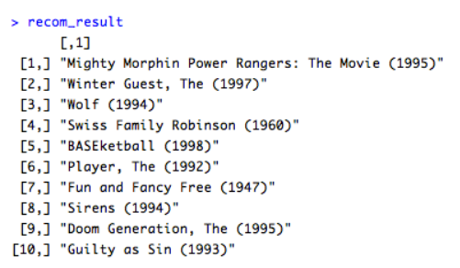

User Based CollaborativeFiltering

Slide 21
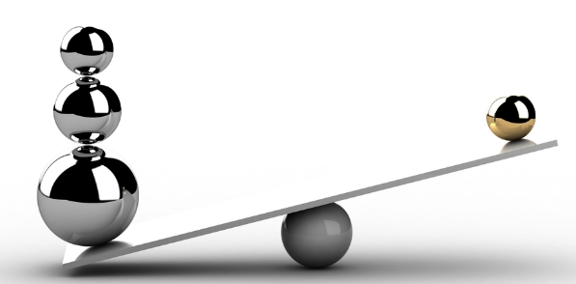
Comparison of models
Item based collaborative filtering, using the cosine as the distance function
Item based collaborative filtering, using the Pearson correlation as the distance function
User based collaborative filtering, using the cosine as the distance function
User based collaborative filtering, using the Pearson correlation as the distance function

Slide 22
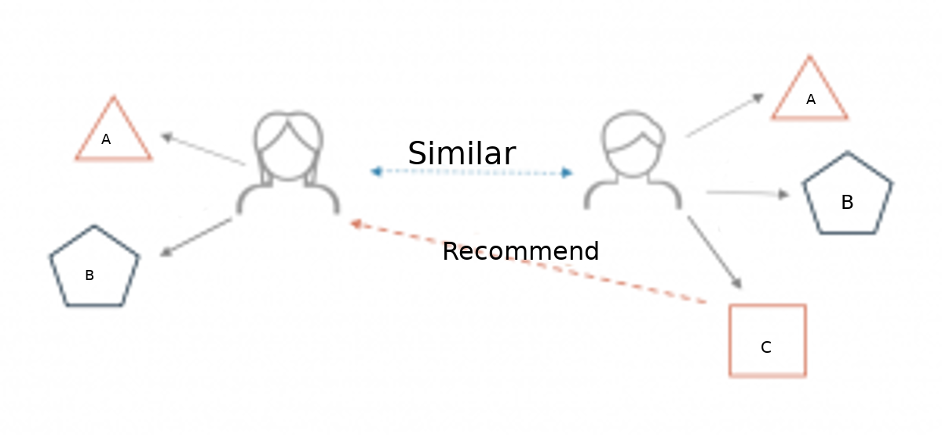
Comparison of models
Cosine Similarity and Pearson correlation
Cosine similarity measures the similarity between two vectors by calculating the cosine of the angle between them.
Pearson correlation measures the association between users and movies based on different aspects like ratings and genre

Slide 23
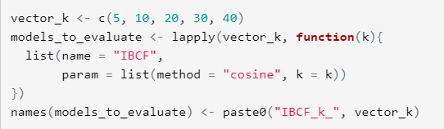
The Item-Based Collaborative Filtering –
Optimizing a numeric parameter
IBCF takes account of the k-closest items. So, it was explored with more values, ranging between 5 and 40, in order to tune this parameter

Slide 24
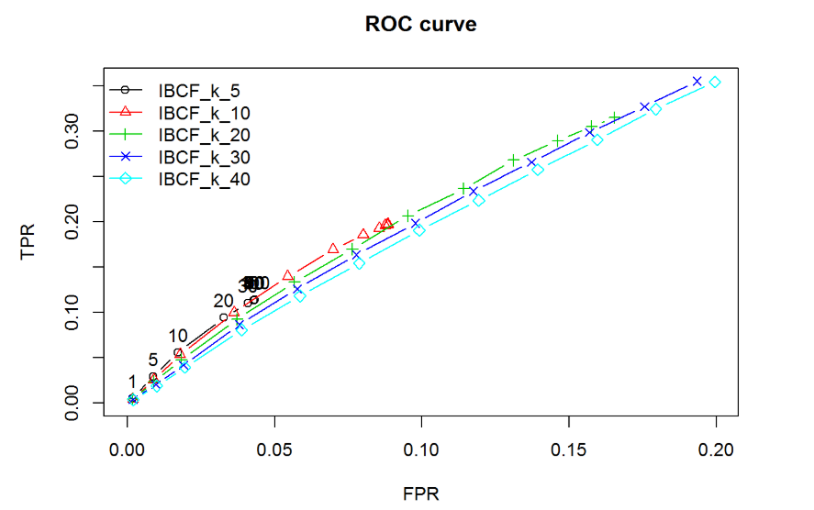
The Item-Based Collaborative Filtering –
Optimizing a numeric parameter

Slide 25
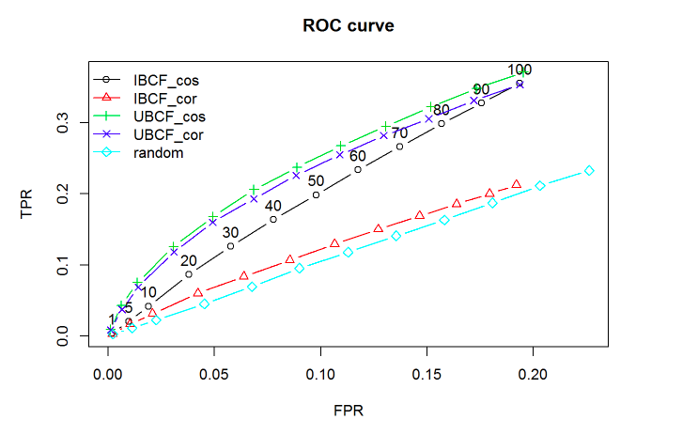
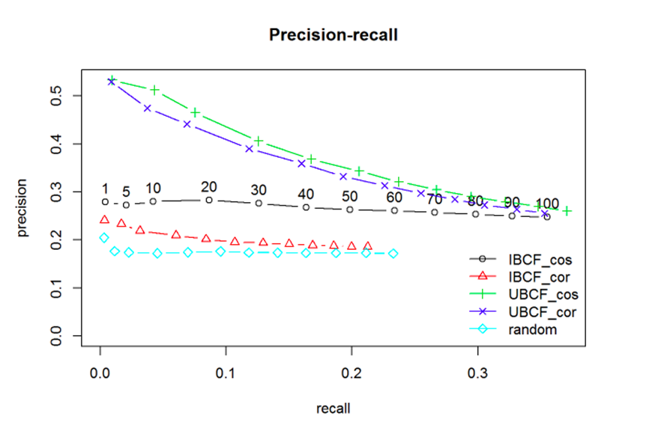
Best Model – ROC CURVE

Slide 26
The Item-Based Collaborative Filtering
Strengths:
Content-based recommender systems don’t require a lot of user data.
You just need item data and you’re able to start giving recommendations to users.
Also, your recommendation engine does not depend on lots of user data, so it is possible to give recommendations to even your first customer as long as you have adequate data to build his user profile.
Weakness:
Your item data needs to be well distributed. It won’t be effective to have a content-based recommender if 80% of your movies are action movies.
Also, the recommendations you get will likely be direct substitutes, and not complements, of the item the user interacted with.
Complements are more likely discovered through collaborative techniques.

Slide 27
The User-Based Collaborative Filtering
Strengths:
User-based Collaborative Filtering gives recommendations that can be complements to the item the user was interacting with.
This might be a stronger recommendation than what a content-based recommender can provide as users might not be looking for direct substitutes to a movie they had just viewed or previously watched.
Weakness:
User-based Collaborative Filtering is a type of Memory-based Collaborative Filtering that uses all user data in the database to create recommendations.
Comparing the pairwise correlation of every user in your dataset is not scalable. User-based collaborative filtering relies on past user choices to make future recommendations. The implications of this is that it assumes that a user’s taste and preference remains more or less constant over time, which might not be true and makes it difficult to pre-compute user similarities offline.

Slide 28
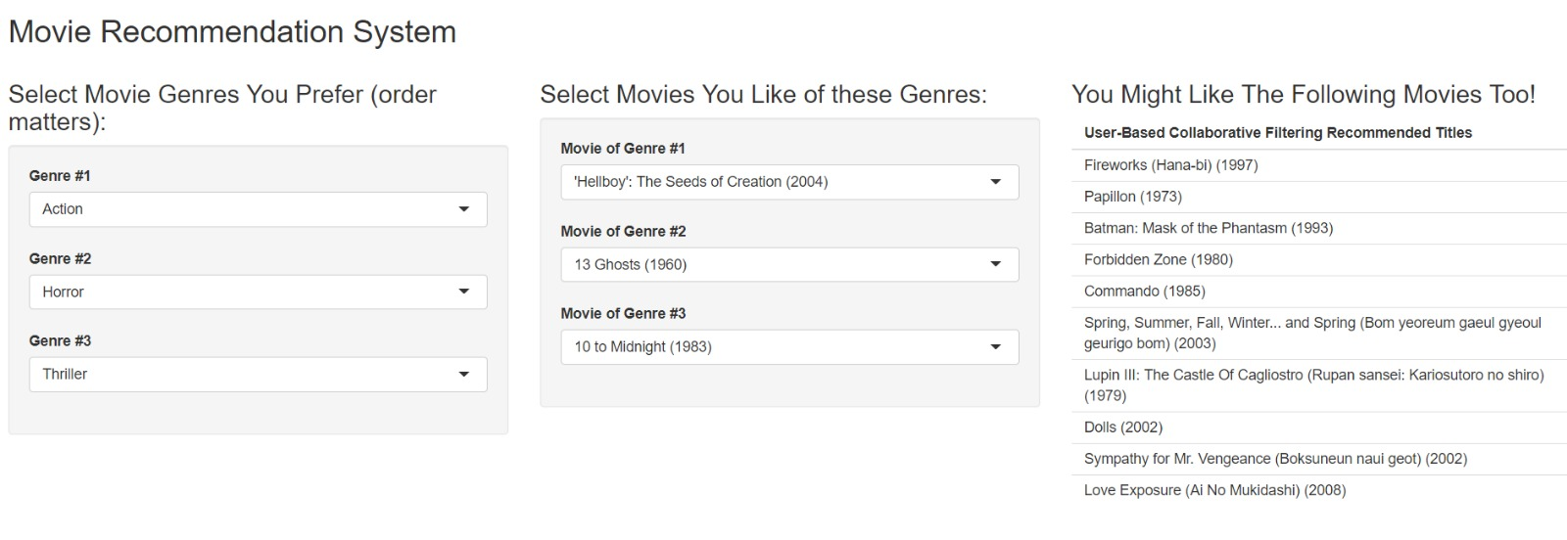
UI Using shiny Apps

Slide 29

Thank You

